Slide 1
RAILWAY BOOKING SYSTEM
CS315 COURSE PROJECT
PRESENTED BY:
Abhishek Bansod (200022)
Anushka Panda (200174)
Gargi Naladkar (200371)
Sana (200599)
Shreya Kacholia (180735)

Slide 2
ACKNOWLEDGMENT
We would like to thank to Prof. Arnab Bhattacharya, our course instructor, for providing us with this opportunity to design and draft this project and the knowledge we gained through it.
We are also grateful to the TAs for this course, without whose support this project wouldn’t have seen this form.

Slide 3
MOTIVATION
Indian Railways is an avenue which is bound to have been accessed by everyone at some point of their lives. Drawing inspiration from the massive scale and its usefulness, we aim to develop a miniature model of Railway Booking system.
We have tried to incorporate and mimic some of its noticeable and much necessary features in the project, using the tech stack we had at our hand.
The model still holds a lot of scope of improvement and we hope to better it with more of our diligent efforts.

Slide 4
SETTING UP THE HOST
We are using a third-party application “XAMPP” to setup the interface for MYSQL and php in order to provide a runtime environment for the hosting of data and front-end.
Following are the steps to configure the setup:
Install “xampp”
Extract the .zip file and add the folder inside “C:\xampp\htdocs”.
Start xampp (MySQL)
Open the MySQL admin and create a new database “ralidraft” and import “railres.sql” from the folder.
Run “http://www.localhost/railres/” and we are ready to use -

Slide 5
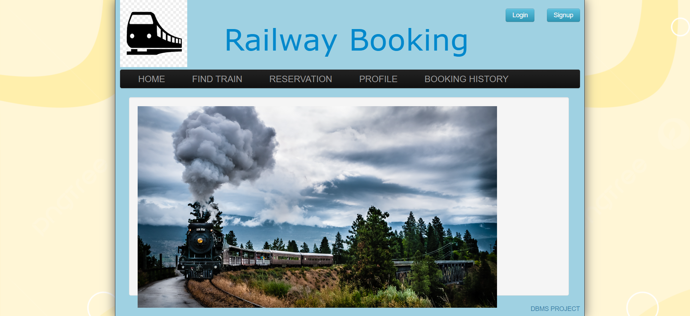
This is how our project looks like -

Slide 6
DATABASES -
We have created 6 tables in our database to simplify our storage information.
Users list – stores the users info
Admins list – Stores the admins info
Booking list – Stores the information about booking of the passengers.
Train list – contains all the the list of trains available
Seats availability list – stores the info about trains and their seats
Interlist – stores info about intermediate stations between source and destination.

Slide 7
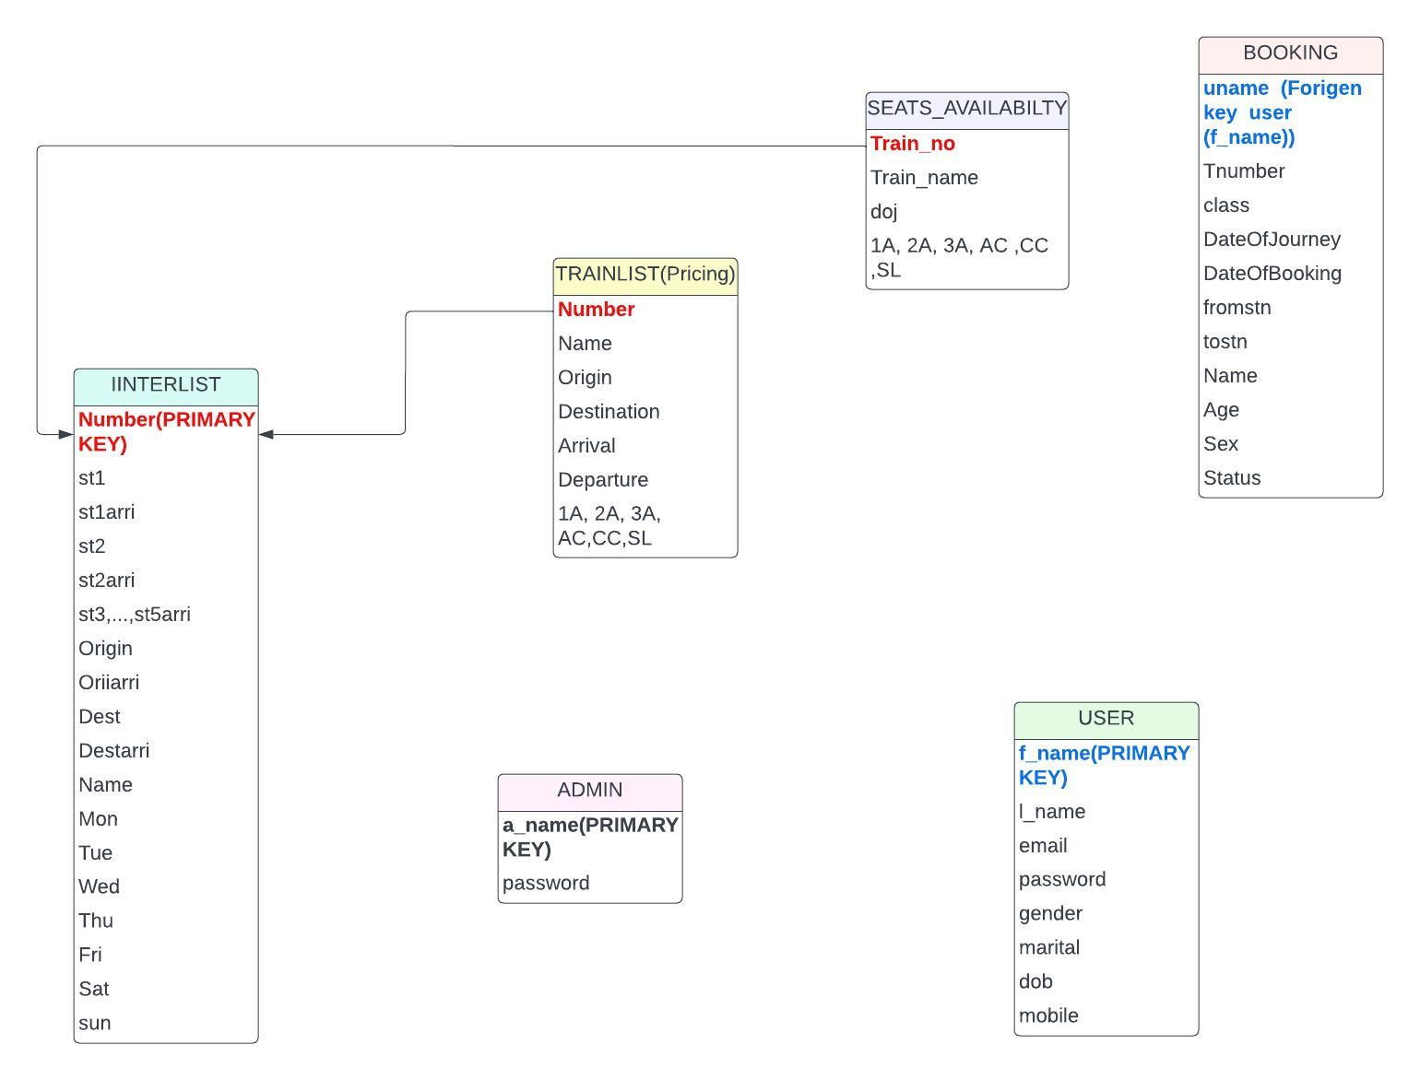
SCHEMA DIAGRAM
(foreign key)
(foreign key)
(Foreign key)
(Primary key)

Slide 8
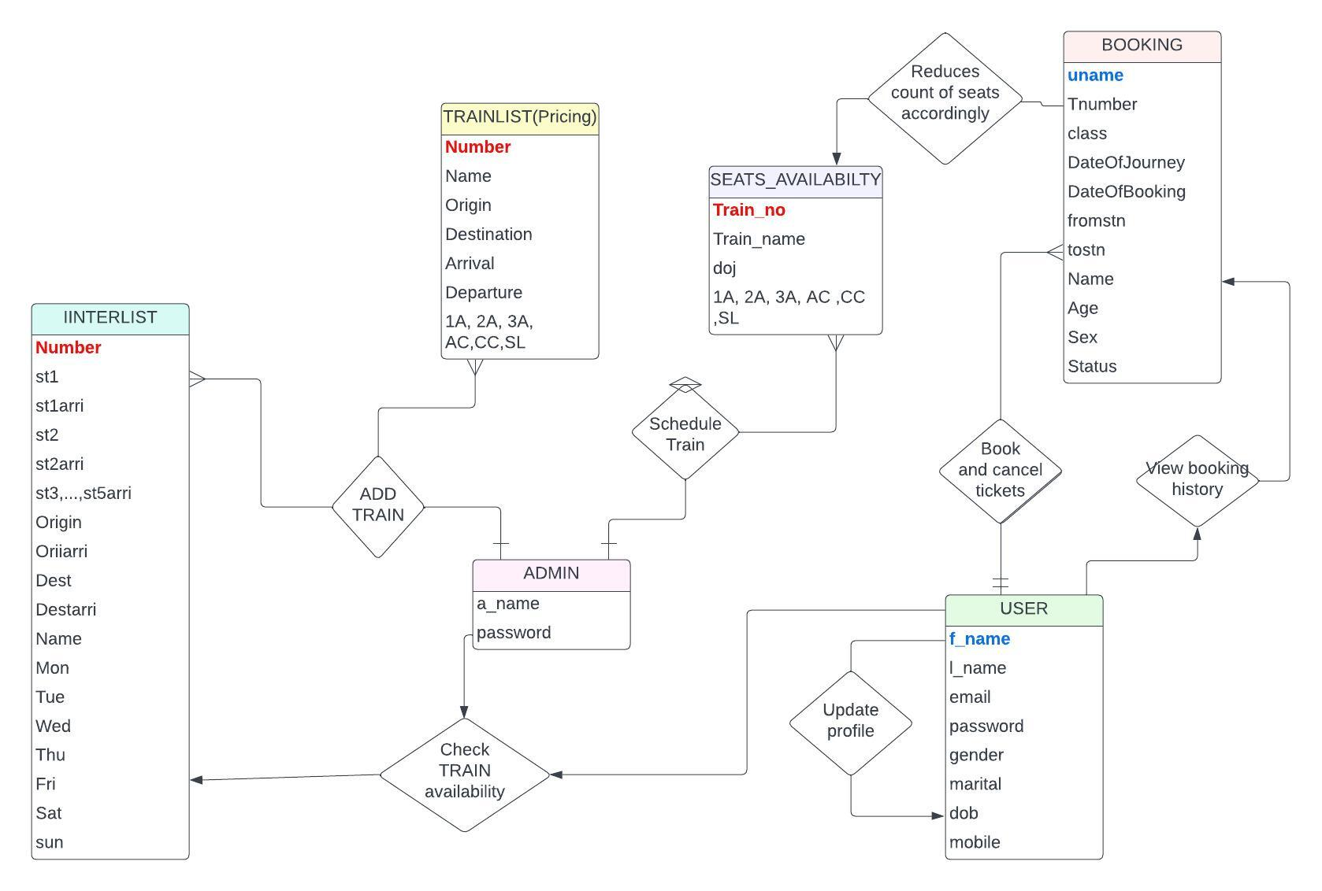
ER DIAGRAM

Slide 9
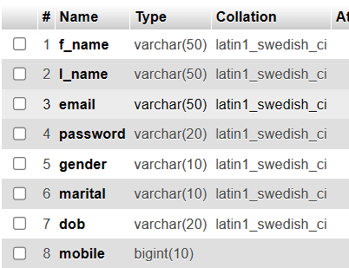
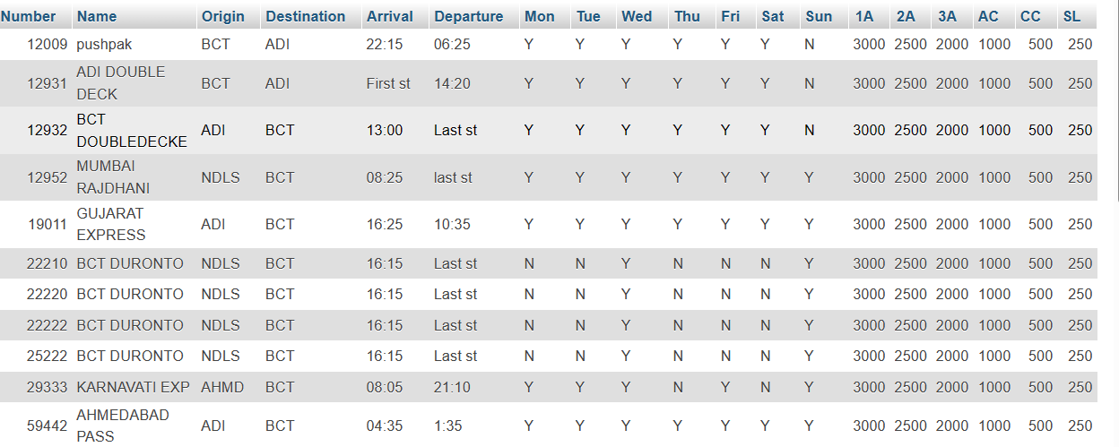
USER PROFILE STRUCTURE
TRAIN LIST

Slide 10
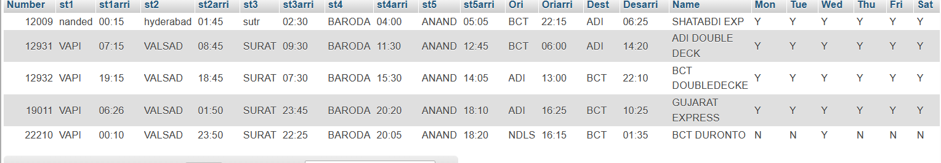
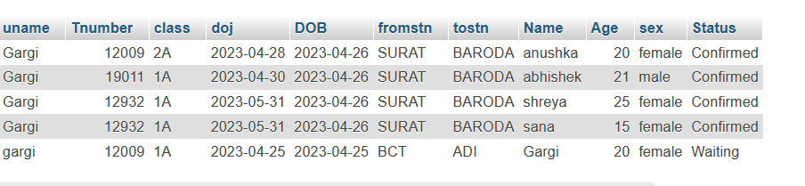
INTERLIST
BOOKING

Slide 11
BASIC FUNCTIONALITIES
SIGNUP
A new customer(user now-onwards) can make up their profile to avail the booking facilities. For the same, they are required to provide the following details in the form presented on the Signup page:
First and Last name
Date of Birth
Gender
Email ID
Password (within the length of 8-32)
Marital Status
Mobile No.
This data collected at Signup helps set up the profile page for our user.

Slide 12
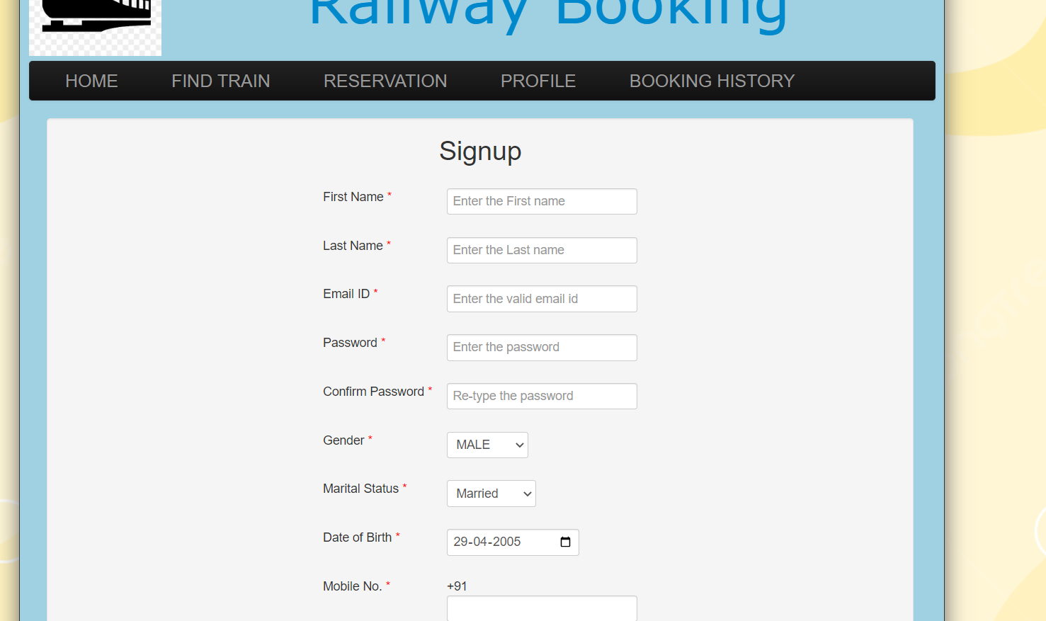
SIGN UP OPTIONS

Slide 13
BASIC FUNCTIONALITIES
LOGIN
The Software provides two interfaces to make the functioning more smooth and organized:
User Login
User privileges allow them to view trains upon querying, their booking history, manage their personal profile.
Admin Login
The Admin enjoys the privilege to manage the backend of the train schedule which include addition and removal of trains into the database, updating the train schedule etc.
LOGOUT
The Logout is a feature accessible to both Admin and Users, for logging out of their account while not making use of the software.
They can login back by using their Username and Password.

Slide 14
BASIC FUNCTIONALITIES
SEARCHING TRAINS
The train searching feature enables the User to view the trains, according to their needs upon querying.
The trains are mainly sorted on the basis of the following:
By Train Name
By Train Number
By Start/Stop Destinations
The User while enjoys only the viewing and querying access, the Admin is given the edit access for this data i.e. the Admin can add/delete trains or modify their schedules according to their running status updates.
User can view the details of the train like arrival and destination stations and their times. It can also view on which days of the week the particular train runs.

Slide 15
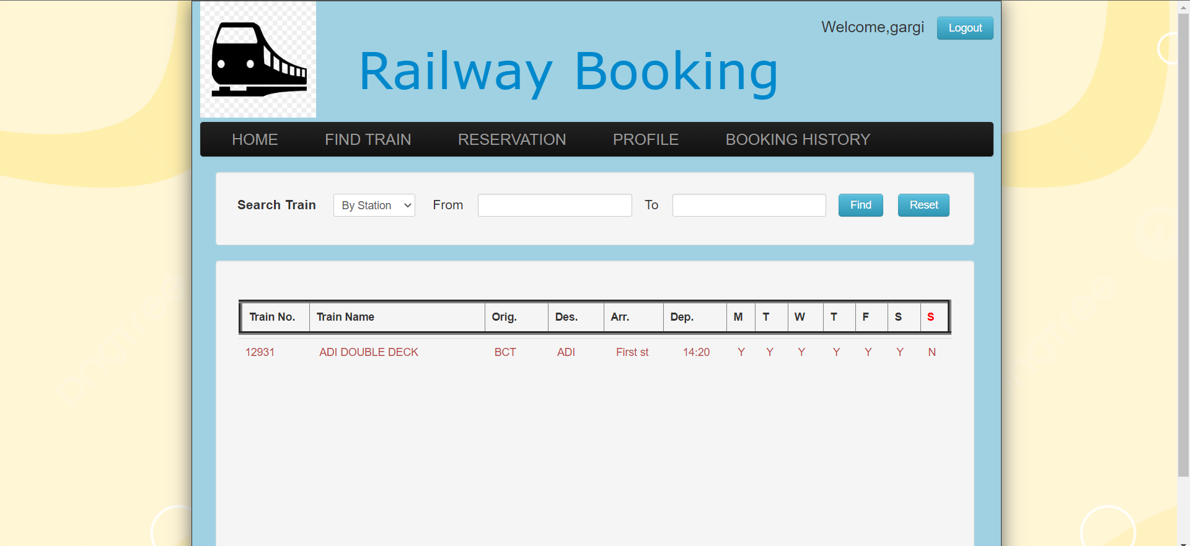
SEARCH TRAIN

Slide 16
BASIC FUNCTIONALITIES
SEAT RESERVATION
After looking up a desired train, the User can finally move onto the Seat Reservation for their journey.
The details required for making reservations are as follows:
Departure Station
Arrival Station
Date of Journey
Following this, we get the available trains satisfying our travel needs and we are free to select a seat amongst them in our desired coach type - 1A 2A 3A CC AC SL.
Post selection of the coach, we enter Passenger details which are Passenger Name, Age and Gender.
Also, we have incorporated the feature wherein a ticket is not issued for children below the age of 5 years and we can book utmost 5 tickets at once.

Slide 17
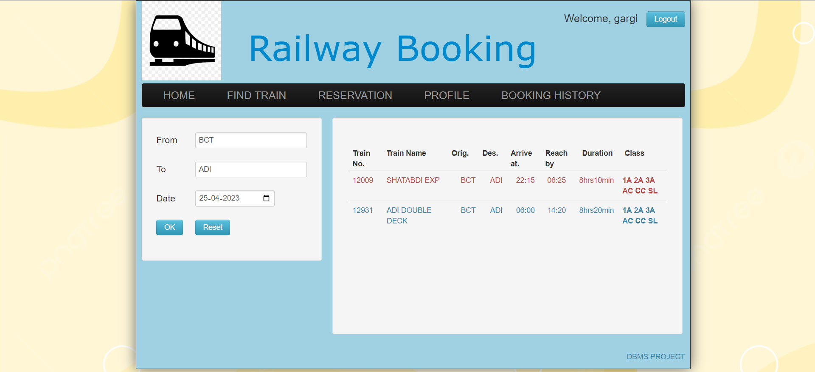
RESERVATION OPTIONS

Slide 18
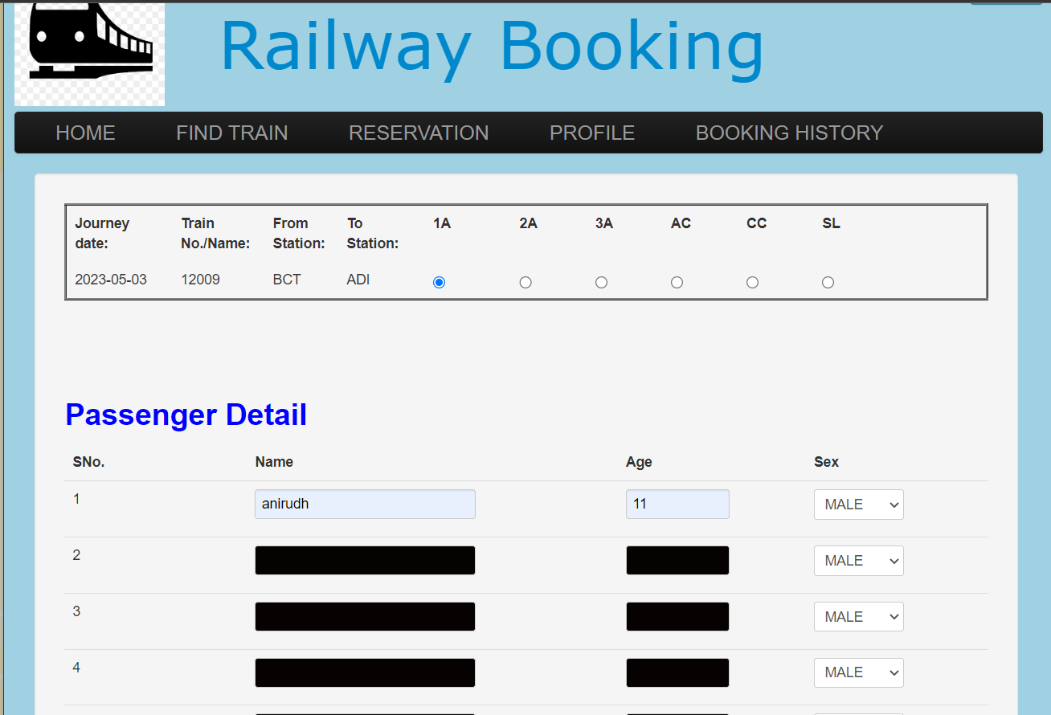
BOOKING TICKET OPTIONS

Slide 19
BASIC FUNCTIONALITIES
BOOKING HISTORY
The User is able to view their Booking History in the “Booking History” tab, which enlists all the ticket bookings made by the user, along with their status of confirmation. Whenever a seat is not available the status is shown as “Waiting”
Besides this, they can also print their tickets.
The user can also cancel their bookings.
TICKET CANCELLATION
User can cancel the ticket
PERSONAL PROFILE
The Users can edit their personal details by accessing the Profile tab.
Besides this, we have also instilled the feature to change their passwords too.

Slide 20
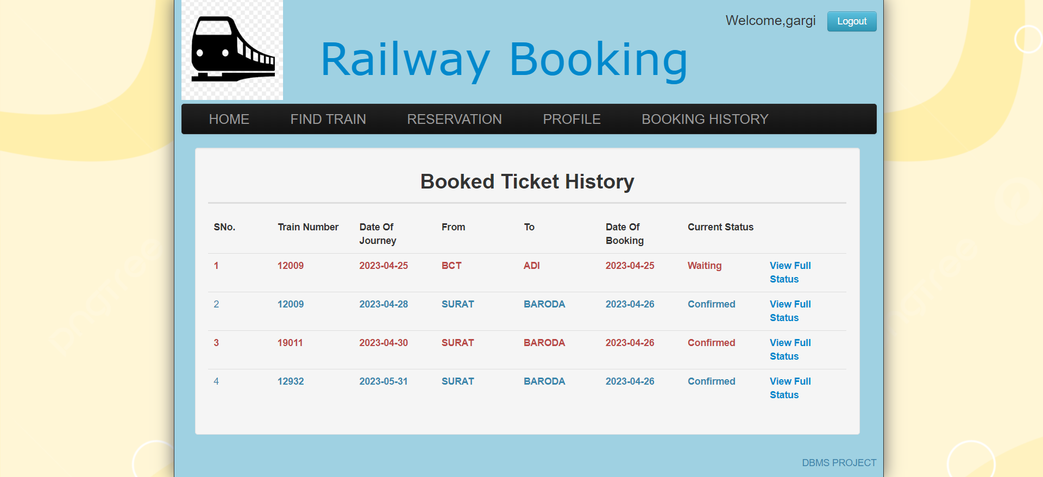
BOOKED TICKET HISTORY

Slide 21
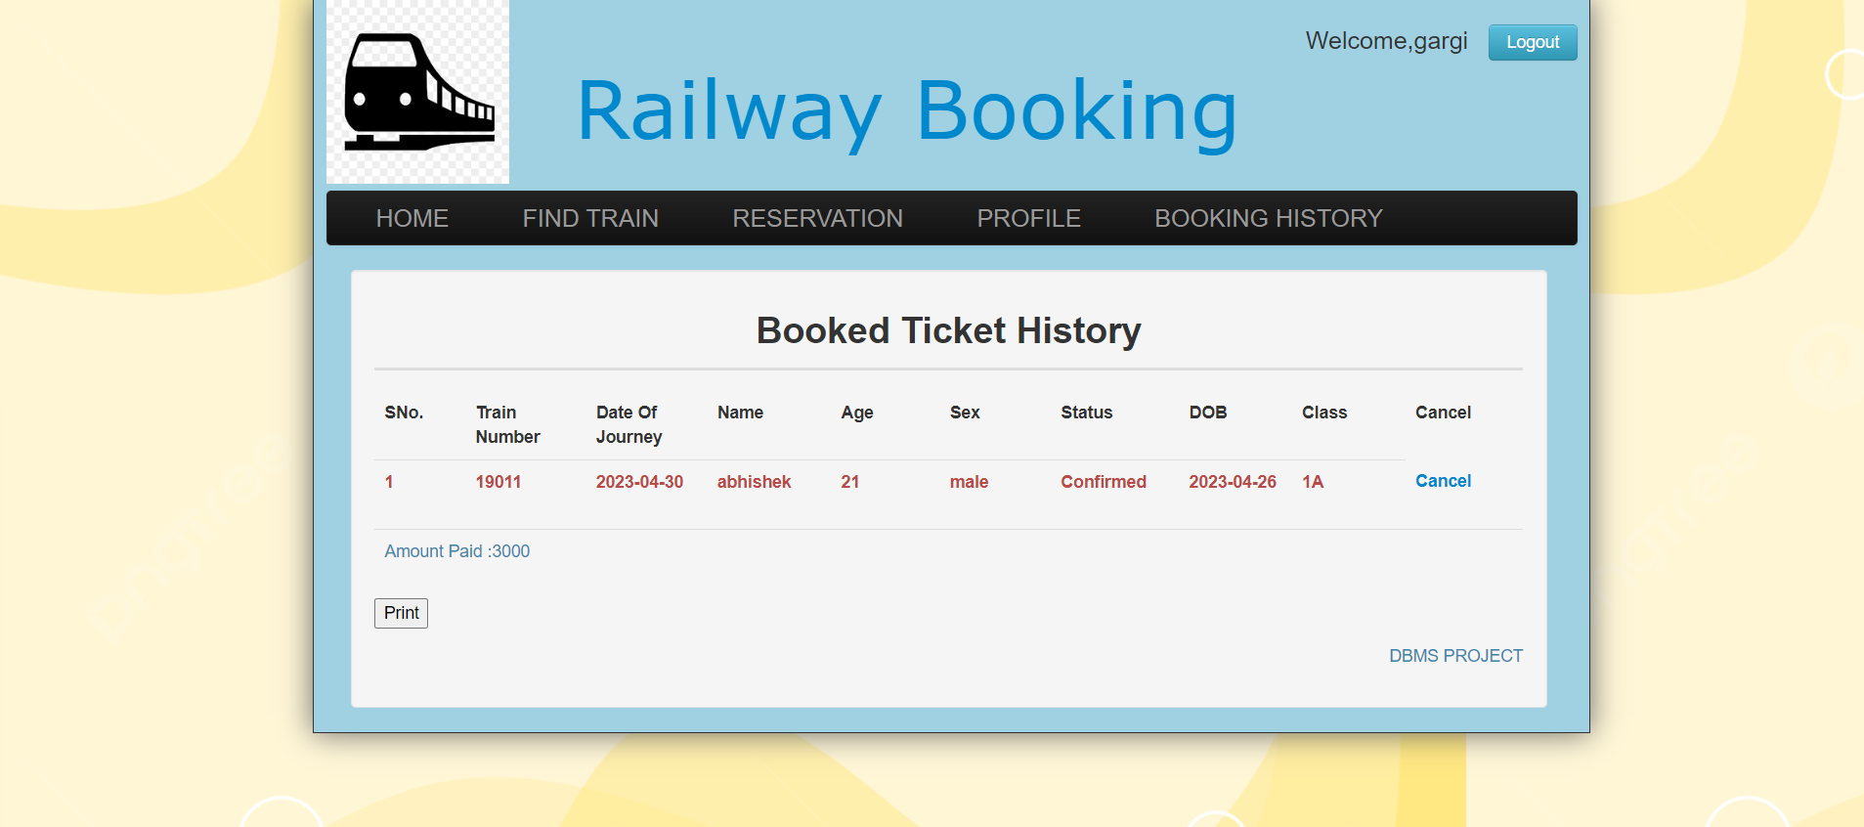
BOOKED TICKET HISTORY

Slide 22
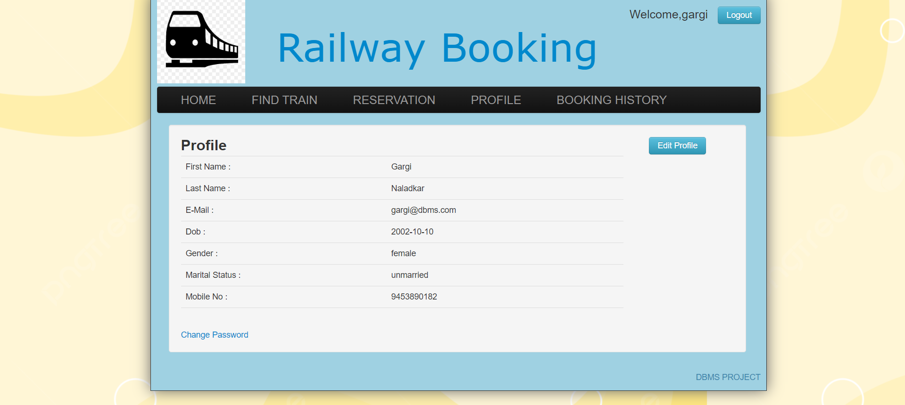
PROFILE VIEW

Slide 23
ADMIN FUNCTIONALITIES
ADD TRAIN -
The admin add a train and its features like train number, train name, origins destination including the timings of train.
It can also decide upon the ticket prices for each of the coaches.
Besides this, they can also print their tickets.
SCHEDULE TRAIN -
Here the admin can decide in what months of the year the train runs.
It also decide upon the number of seats available in a train for every coach.

Slide 24
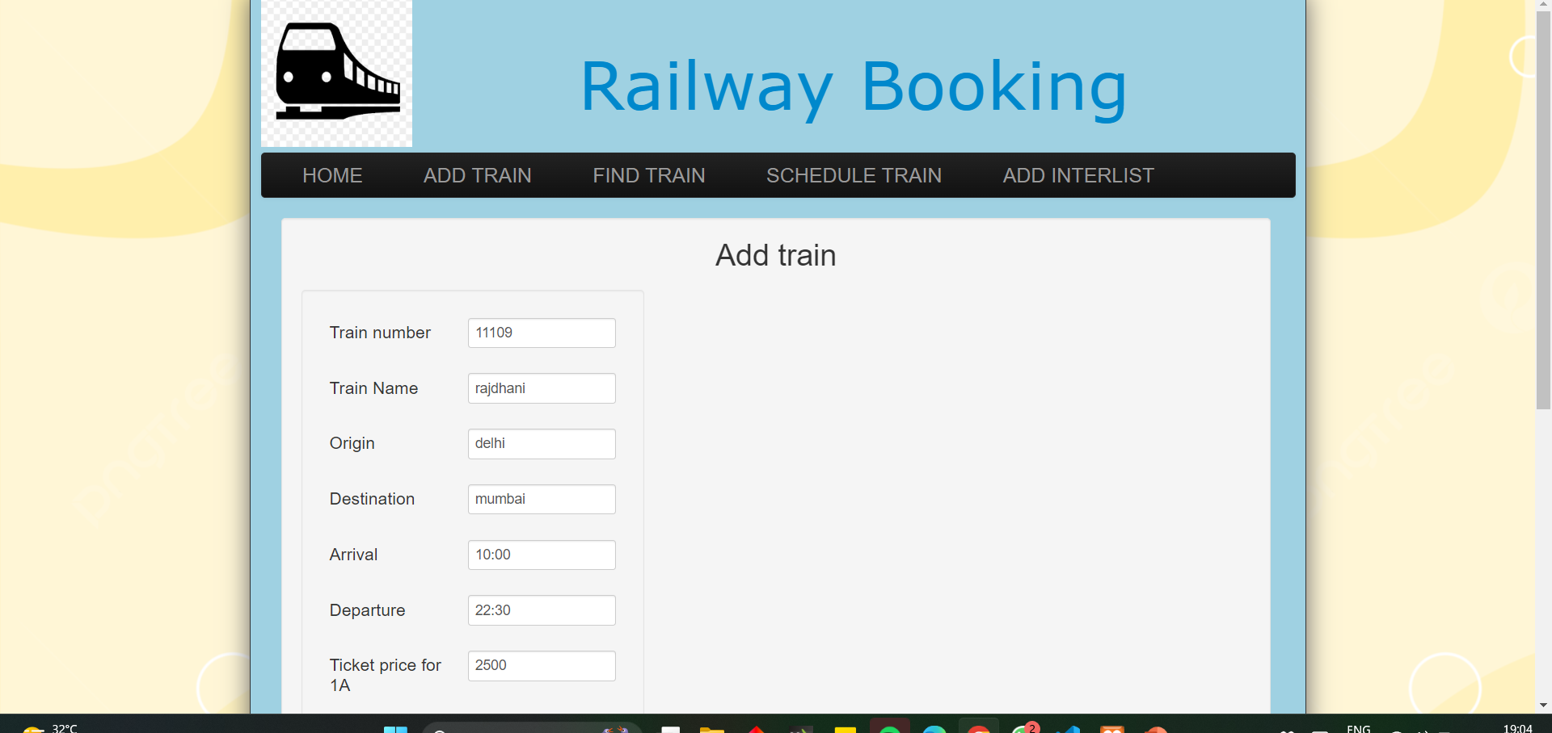
ADD TRAIN(ADMIN FEATURE)

Slide 25
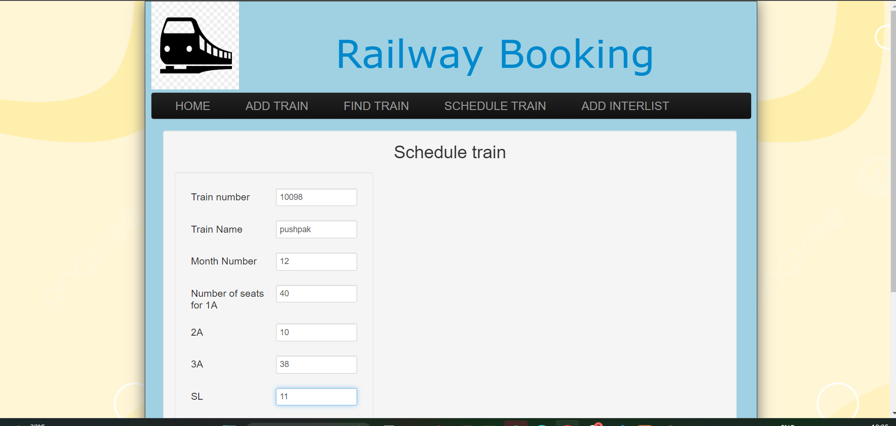
SCHEDULING TRAINS(ADMIN FEATURE)

Slide 26
ADMIN FUNCTIONALITIES
ADD INTERLIST
The admin can select on which stations a particular train passes through including the arrival timings.
The admin can decide on which days of the week it can run.
Admin can schedule a train after adding a train and adding the stations in the interlist.

Slide 27
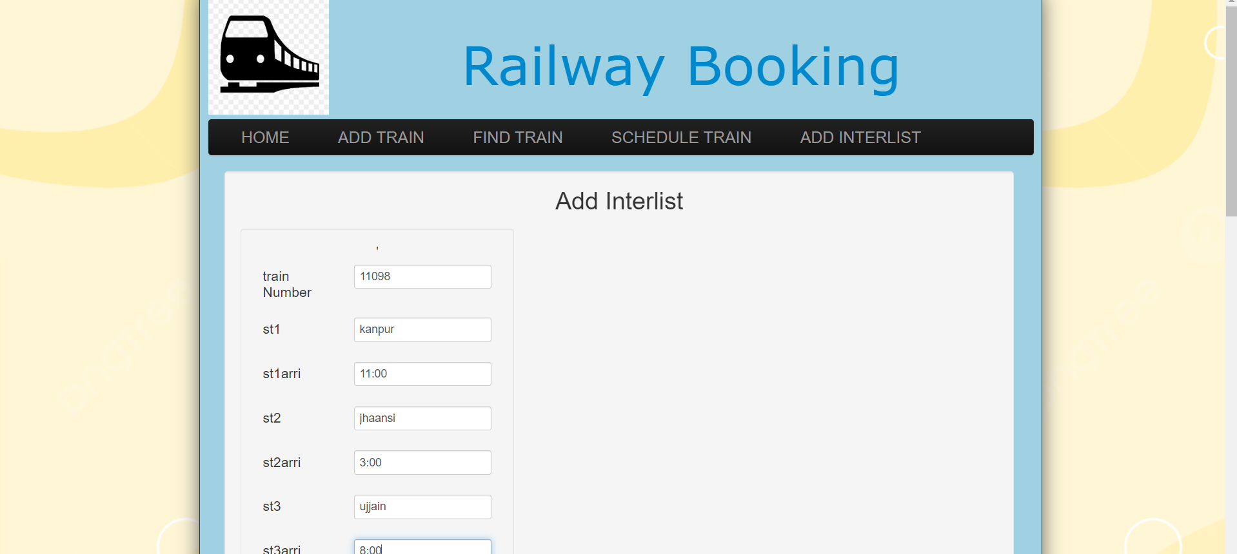
ADD INTERLIST (ADMIN FEATURE)

Slide 28
TECH-STACK EMPLOYED
Front end: HTML, CSS,Bootstrap, JavaScript
Back end: PHP, MySQL
PHP: Hypertext Preprocessor (PHP) is a technology that allows software developers to create dynamically generated web pages, in HTML, XML, or other document types, as per client request. PHP is open source software.
MySQL: MySql is a database, widely used for accessing querying, updating, and managing data in databases.

Slide 29
POSSIBLE IMPROVEMENTS
If we find case of cancelation it would be better a feature to change waiting status into confirmation whenever..
If user can book tickets for the in-between stations but he/she needs to pay the full amount of the train ticket. This is one of the features that needs improvement.
We also plan upon introducing different quotas like tatkal, senior citizens and ladies reservation as found in actual IRCTC booking systems.

Slide 30
THANKS!!

